Slide 1
Starter
We want a guide for all picture sizes in the web.
We want to edit anything on the web from the control panel (Icons, messages, anything)
Buttons to be Red , Background Navy
Add Code of the colors.

Slide 2
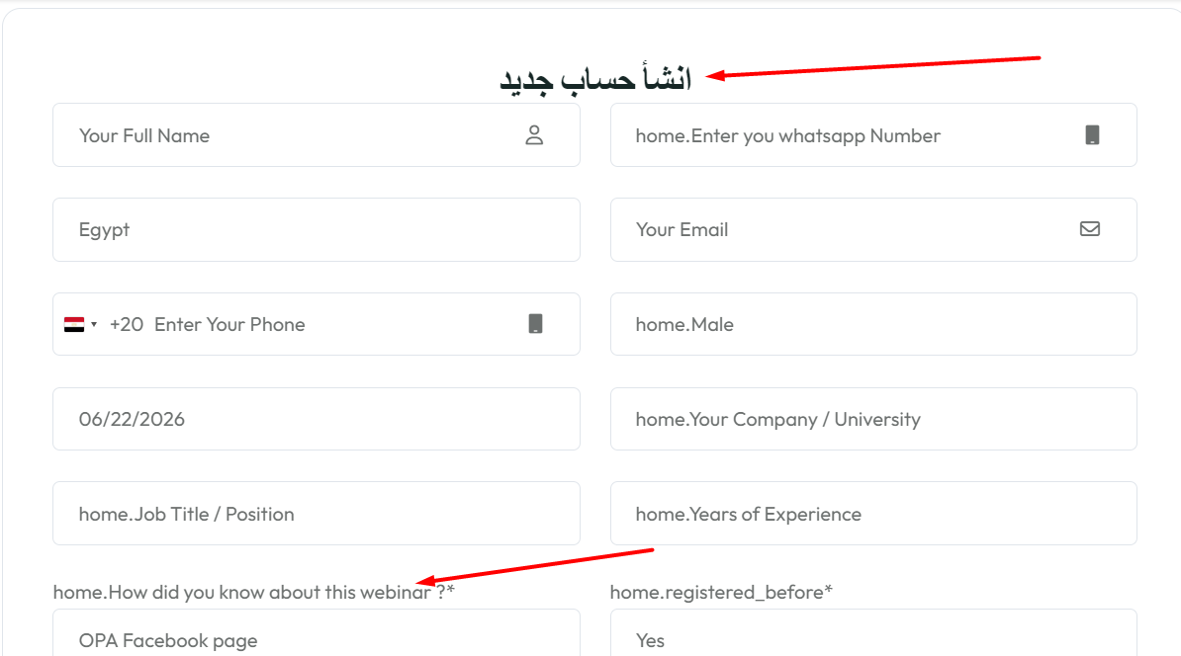
Arabic to English
Remove this webinar and change it into us

Slide 3
New Courses Certificate PSD File.
https://drive.google.com/file/d/1Kv5vVZ7XDeXWMEvXv7b2FdxQfo9qHab-/view?usp=sharing
Body Font: Poppins Weight: Semi Bold Size: 27pt
Date Font: Poppins Weight: Medium Size: 30pt
Serial Font: Milker Weight: Regular Size: 30 pt

Slide 4
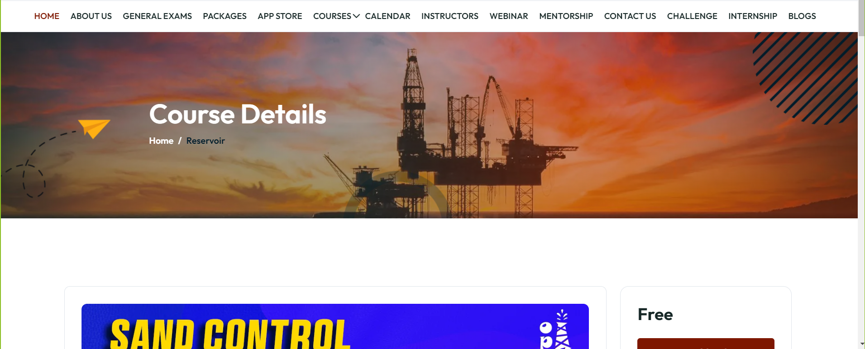
Remove this header from all website pages

Slide 5
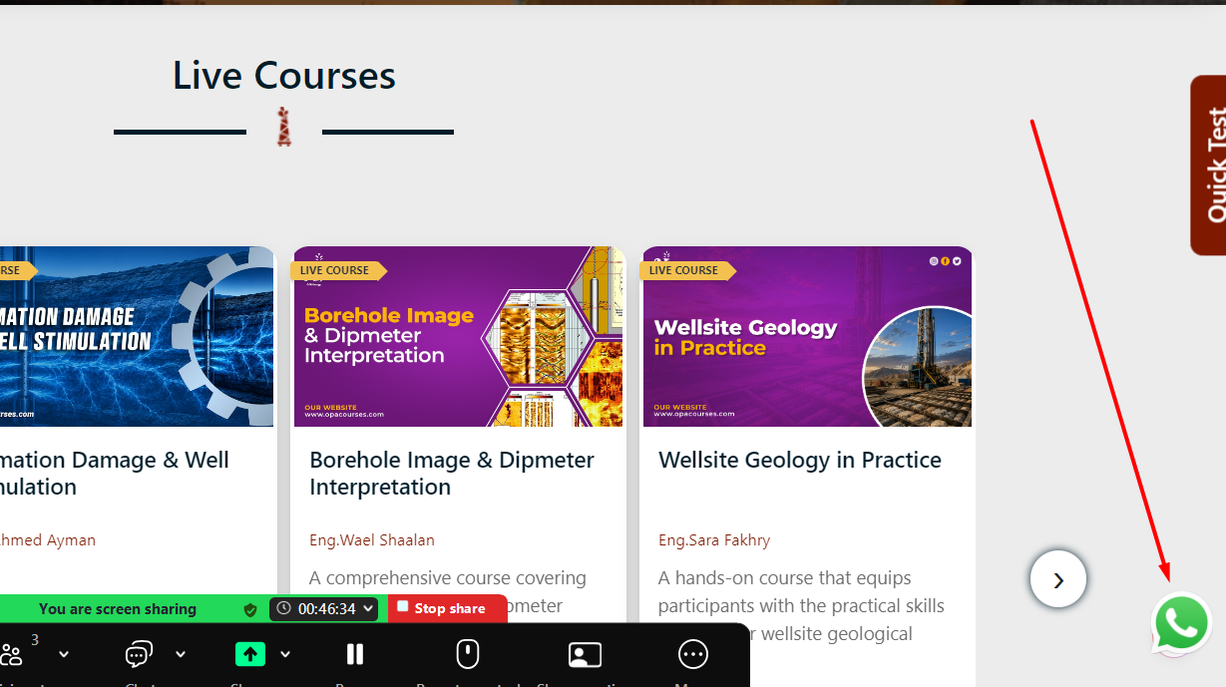
Add WhatsApp Chat Icon

Slide 6
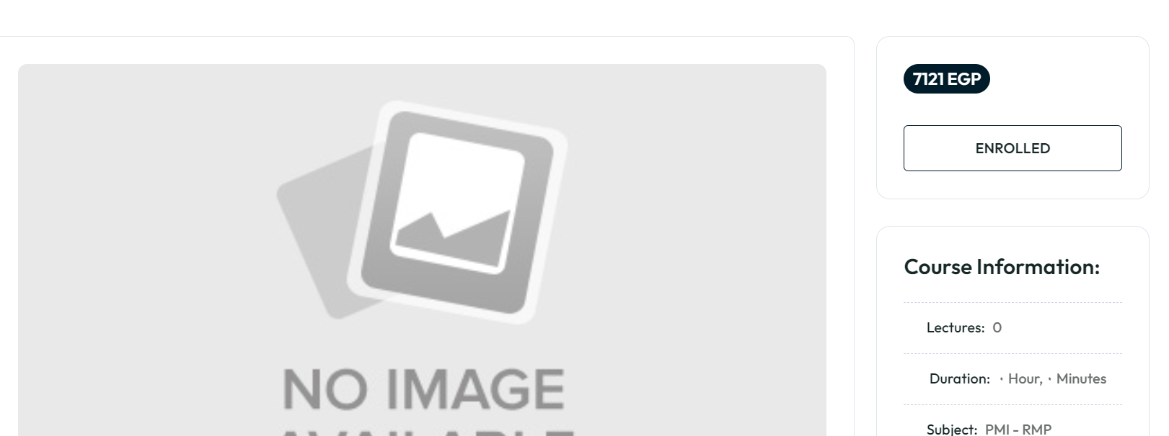
Price in $ not EGP

Slide 7
https://opa.hyper-design.com/Home/about_us
I want a section called Documents
I want to easily add buttons and rename them from control panel
Add New Table in control panel with
Document Name
Status
Upload File

Slide 8
Remove (home.) From all sections in website

Slide 9
PDF Preview
Is there an embedded PDF Preview on the website instead of downloading the file.

Slide 10
In Any Payment
Add Transfer Fees row with percentage of the total.
The Percentage to be edited from control panel
Percentage of the total in cart page

Slide 11
Feedback Form
I want to make a feedback form for all courses in the website.
https://opa.hyper-design.com/showCourse/5/Reservoir-Engineering/feedback
Course Feedback Link: ?????
Webinar Feedback link: https://forms.gle/aGsZmKdN6MARByTC9

Slide 12
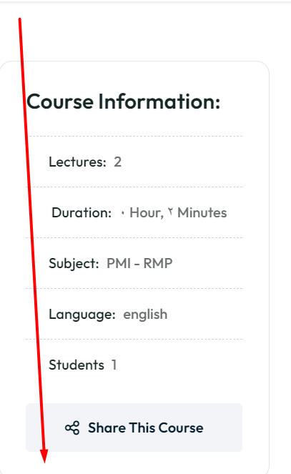
WhatsApp Group
I want a WhatsApp Group Link for each course, can be only seen for people who bought the course.
Join Course WhatsApp Group
Join Ambassadors Group

Slide 13
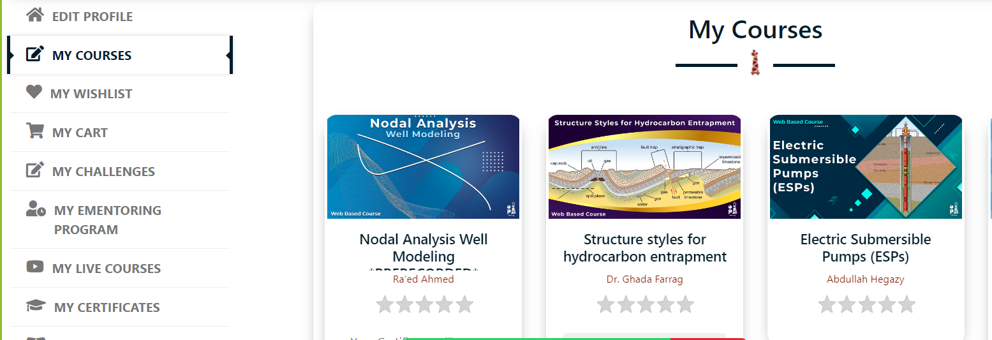
In User Profile
I want a tab to let customers to see their unbought courses.
Split them into pages

Slide 14
I want an option to reset instructor balance to 0

Slide 15
In Control Panel, I must add Arabic input in each section
Like Arabic Course Name, Arabic Text, etc…
Remove it.

Slide 16
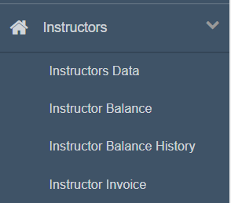
Where’s instructor tab in new control panel

Slide 17
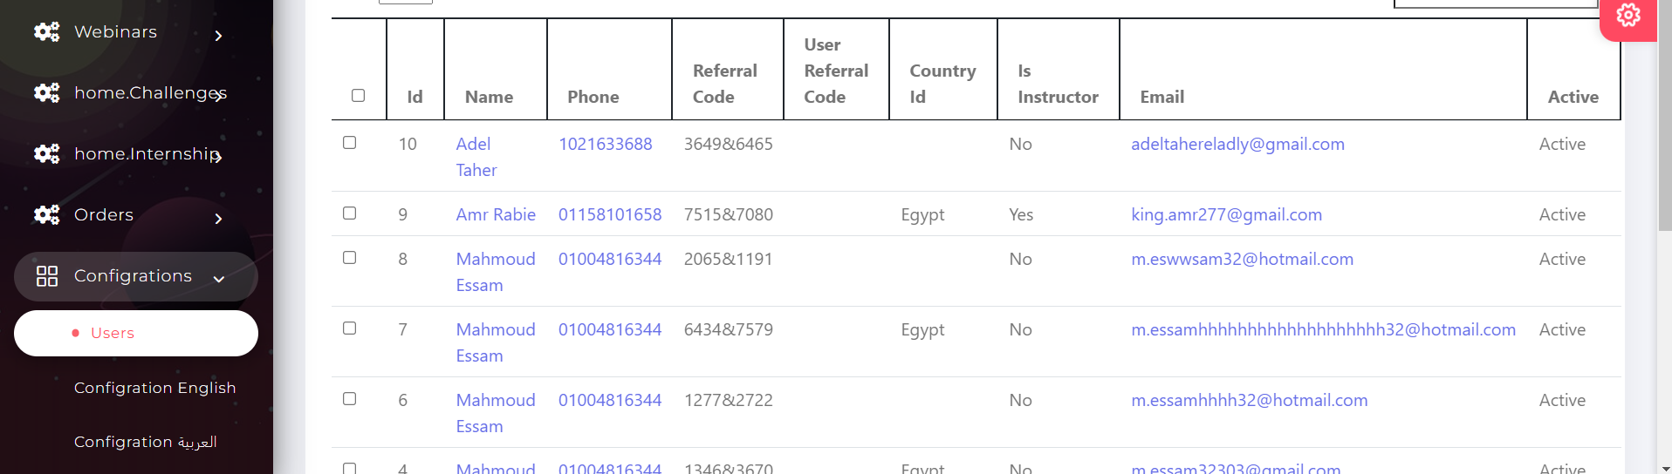
Add the rest of the registration form (Job – Experience- gender – birthday- etc…)

Slide 18
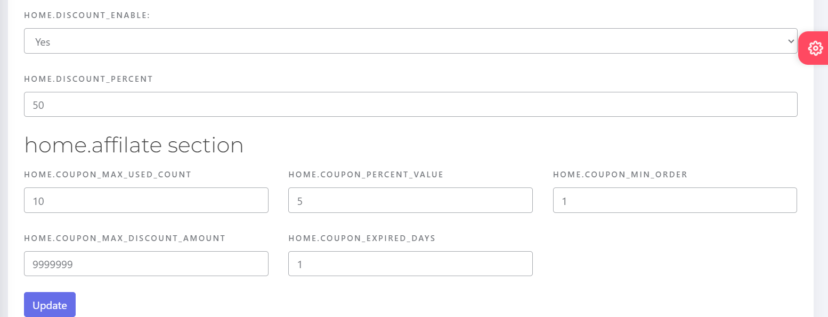
Home Discount Not Working

Slide 19
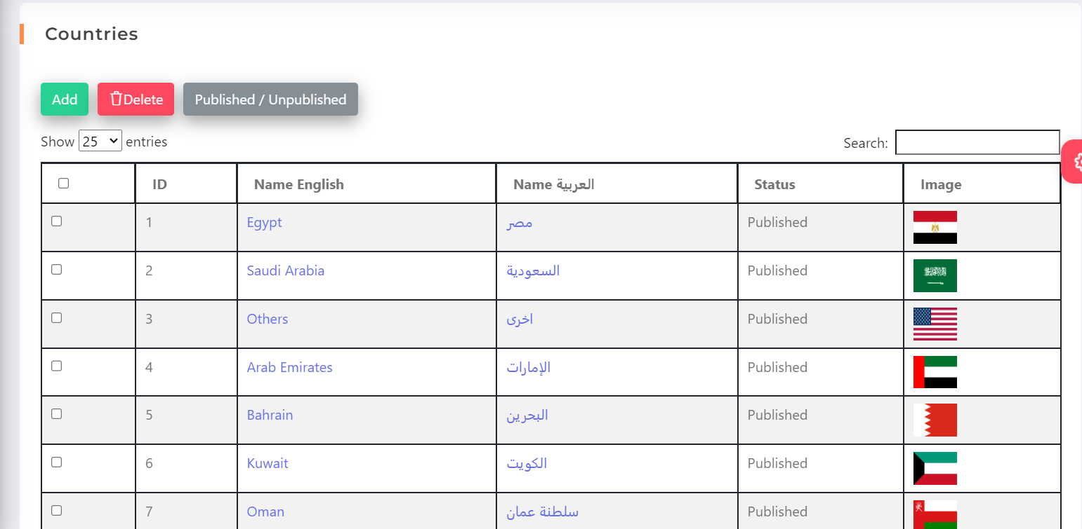
What’s this for?

Slide 20
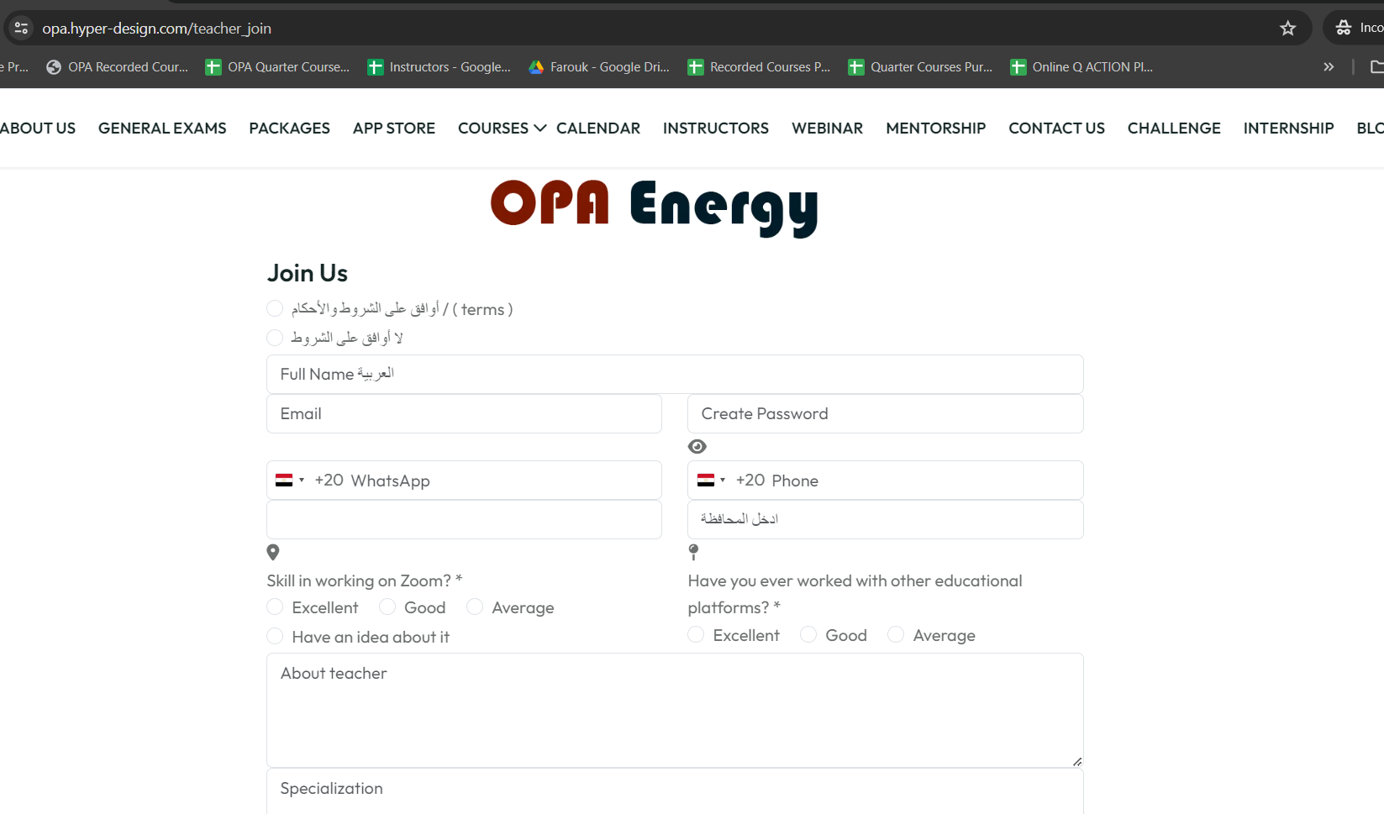
Apply for Instructor Form isn’t the same, and where the application is sent to?
SAME AS OLD

Slide 21
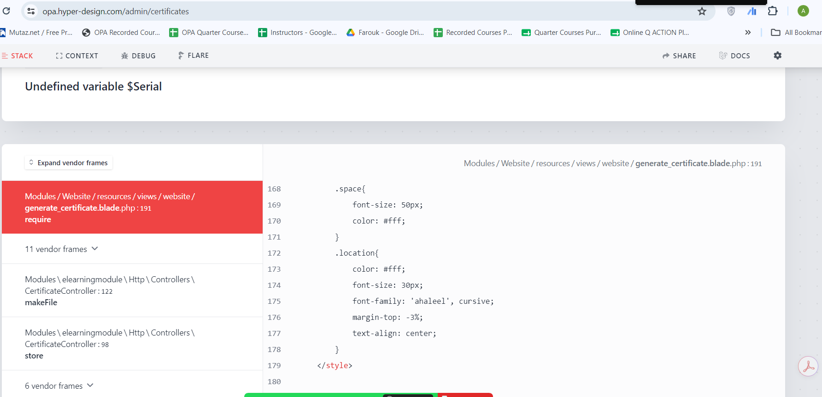
Certificates in Courses tab in control panel showing error. https://opa.hyper-design.com/admin/certificates

Slide 22
In Course Assginment in control panel
Make it by email or name.

Slide 23
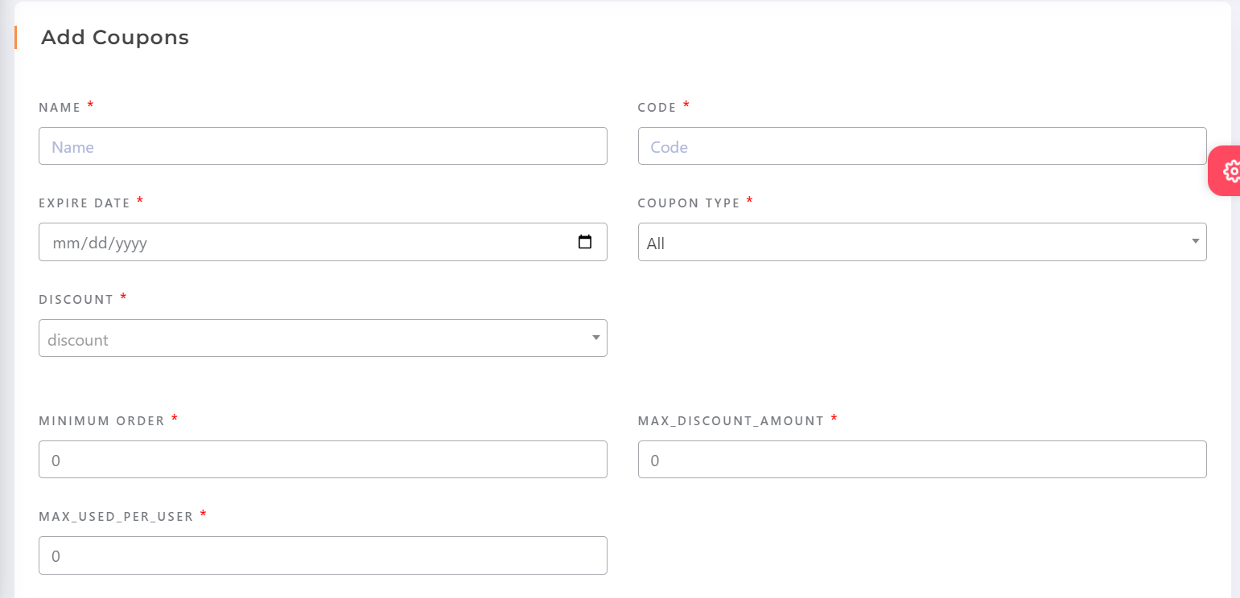
Affiliate Coupon should be linked to a user to give him the credit
Select User ID

Slide 24
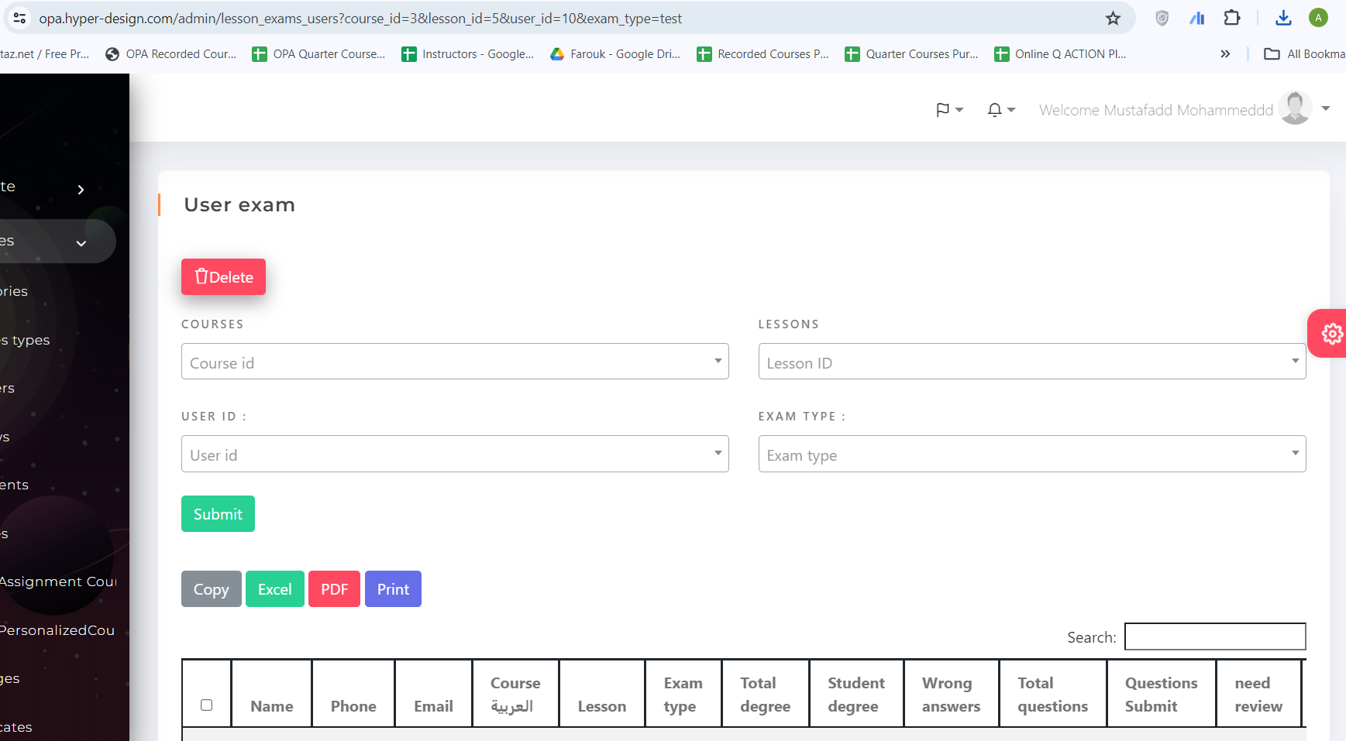
User Exam in Control Panel, how it works?

Slide 25
Can’t Create Challenge or Internship form

Slide 26
About us not working from control panel

Slide 27
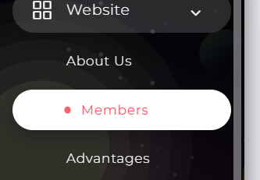
Members Working but Images needs Adjustment

Slide 28
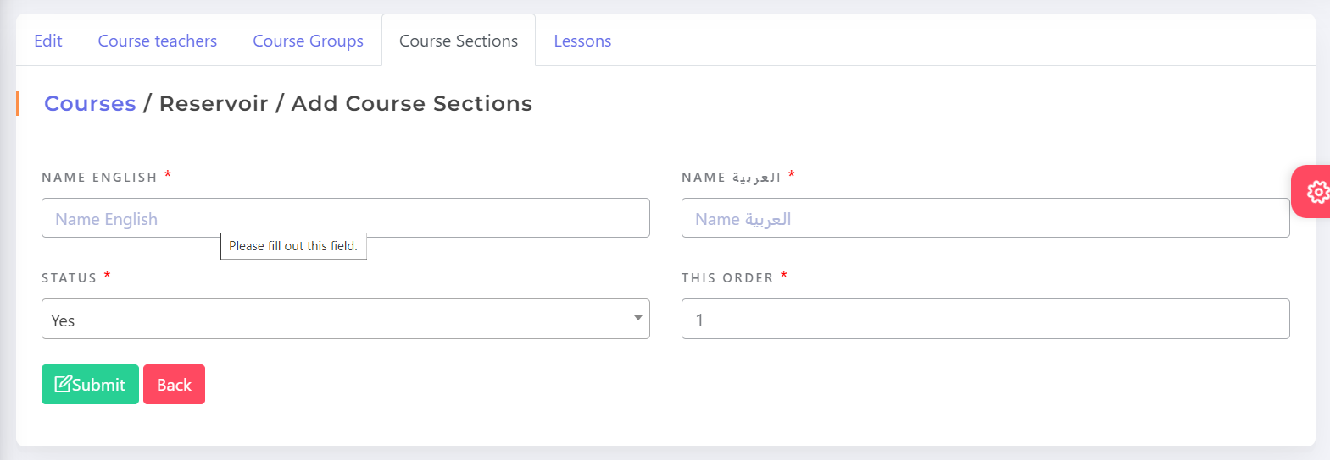
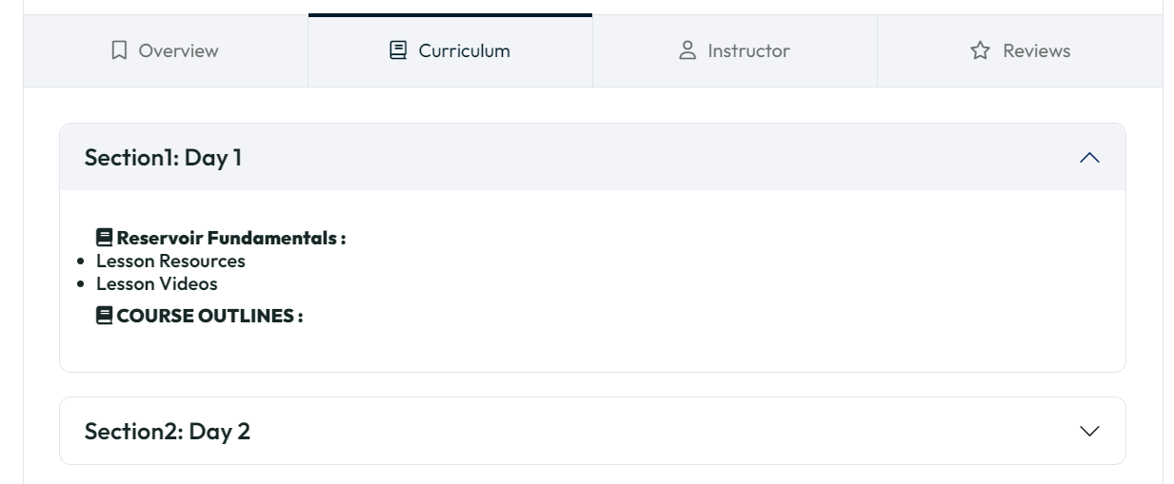
Add Descriptions for Sections in Courses

Slide 29
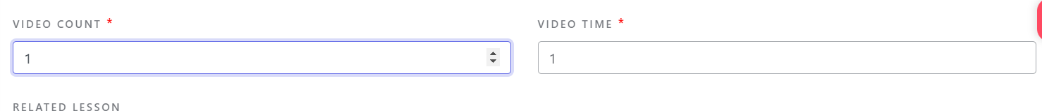
What do you mean? Adding lesson from control panel

Slide 30
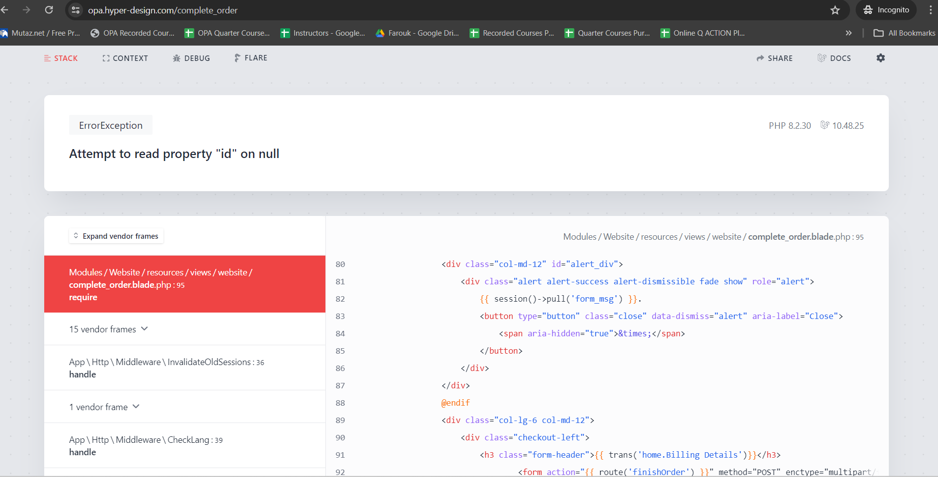
Buying Free Course

Slide 31
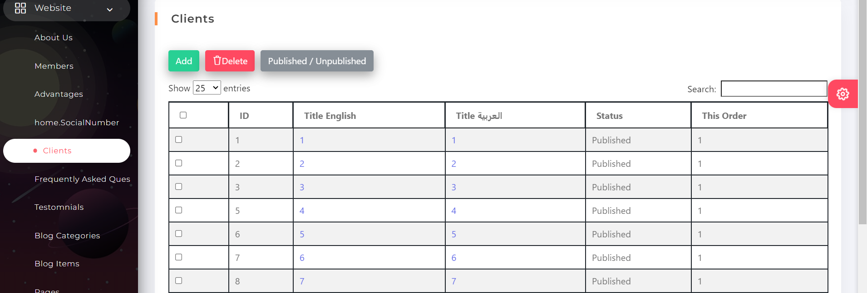
Can’t delete

Slide 32
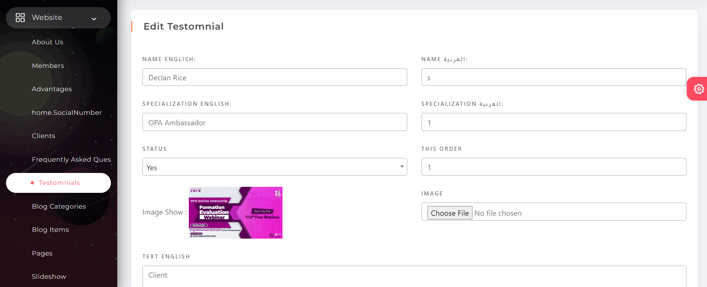
Add Date in Testimonials

Slide 33
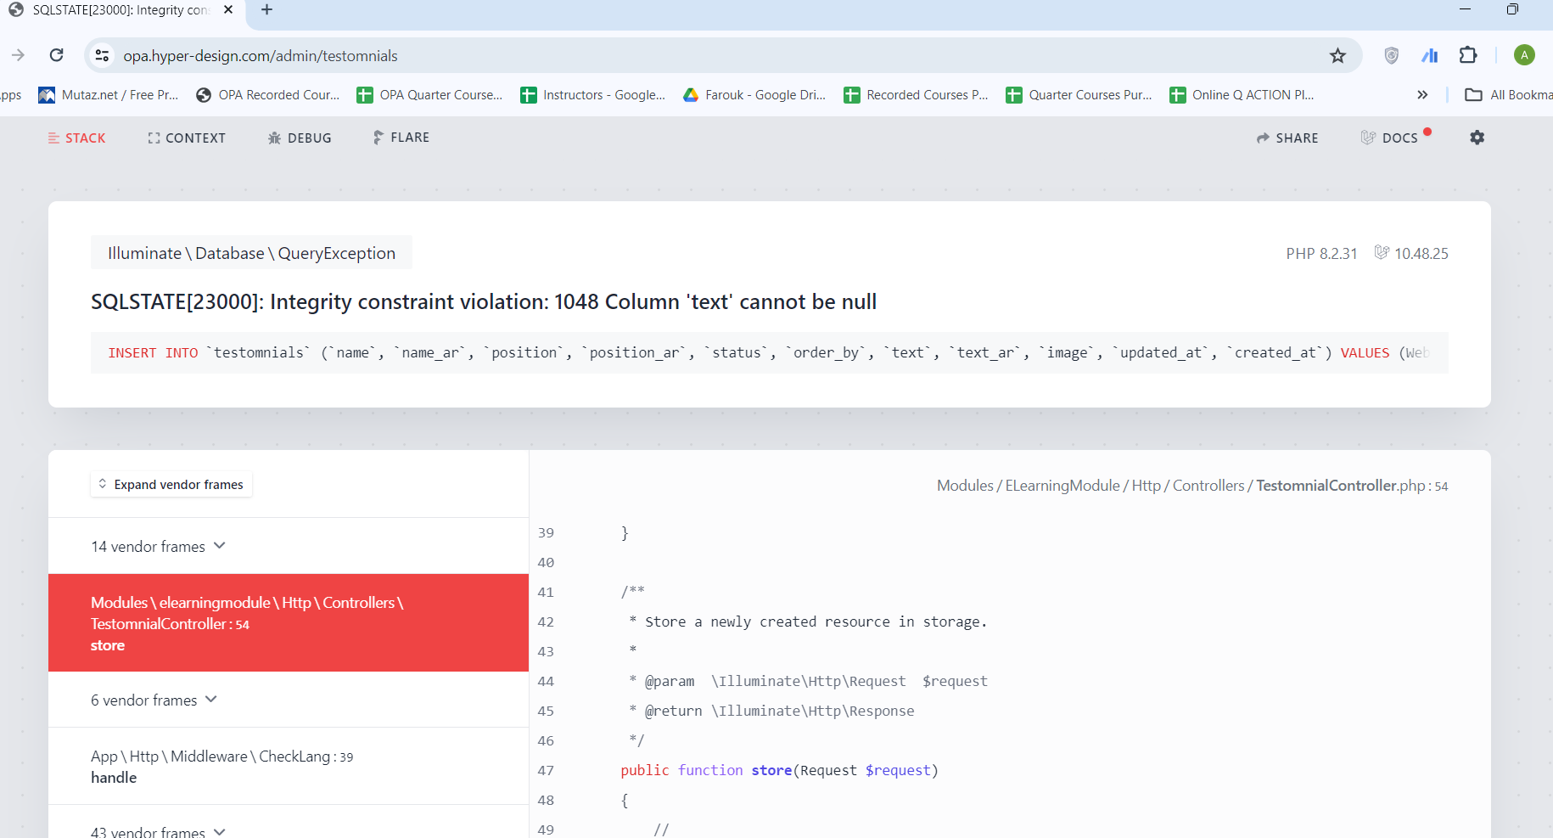
Testimonials, Adding Image without Text.

Slide 34
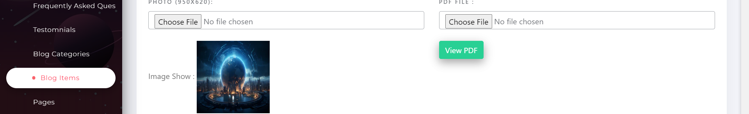
Blog PDF isn’t Working

Slide 35
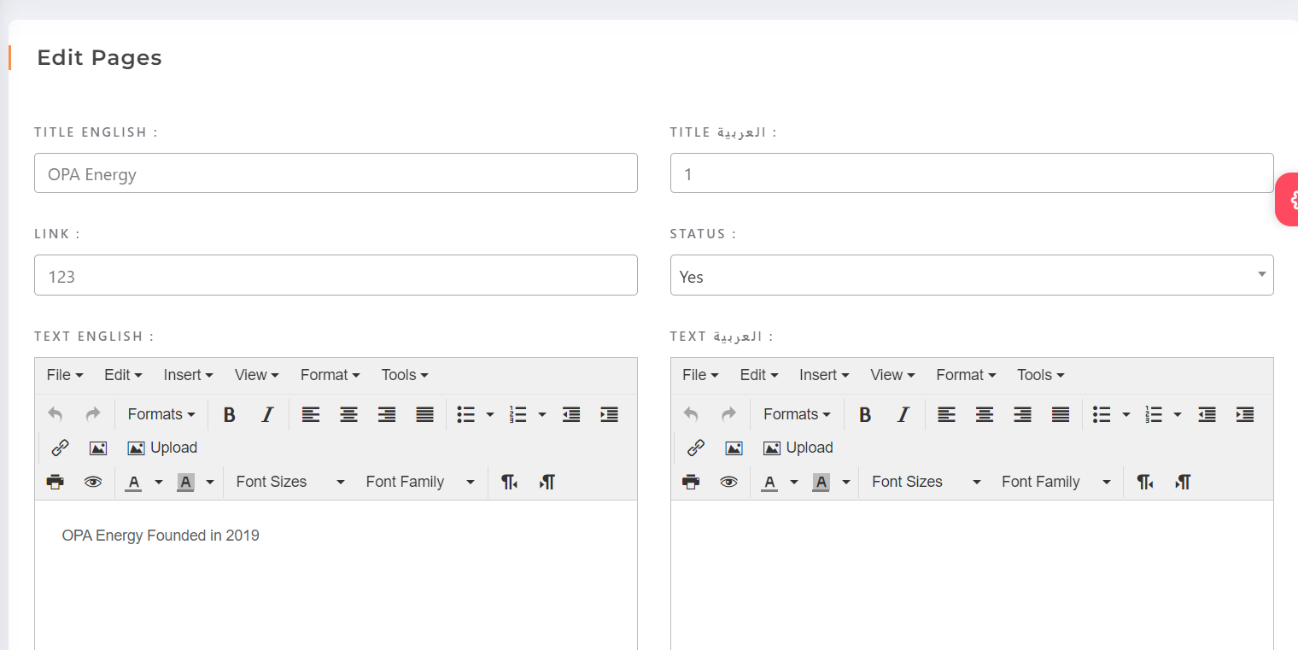
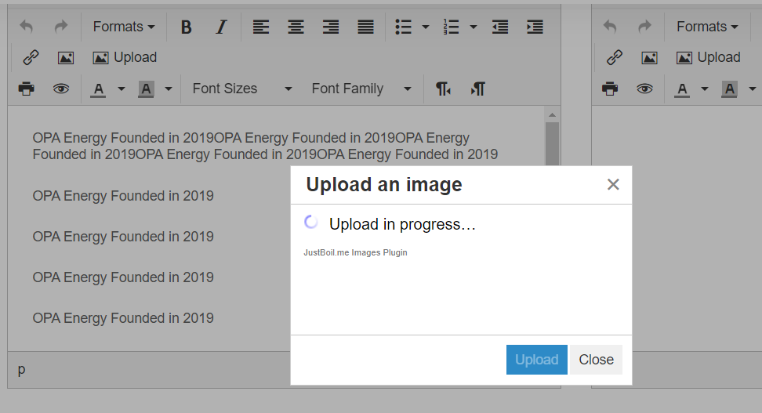
In Pages in control panel, Add Image, PDF Option

Slide 36
https://opa.hyper-design.com/Home/gallaries

Slide 37
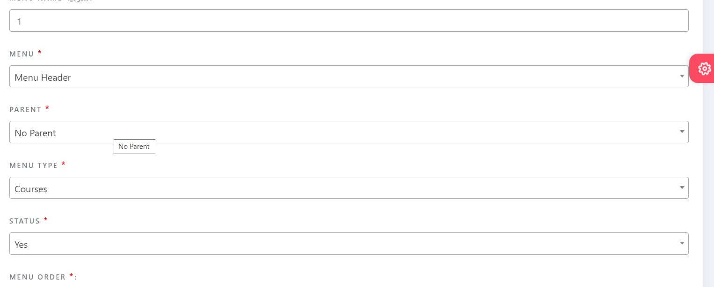
In Menu Type, Add Categories & Course

Slide 38
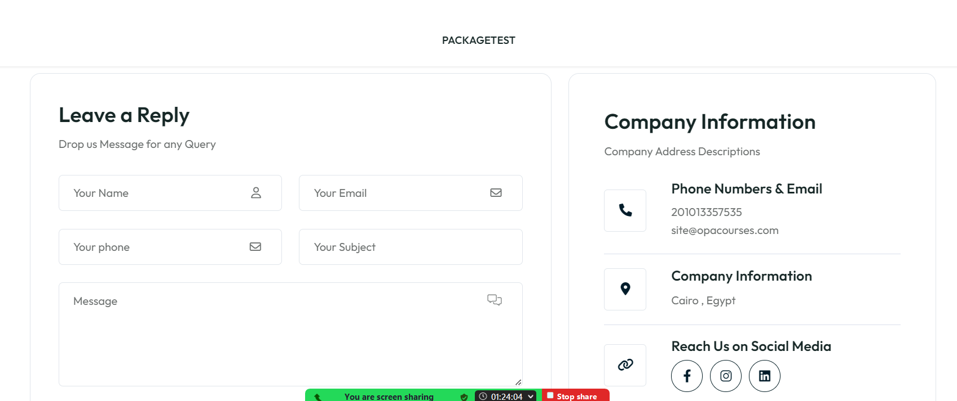
Contact Us, where edit? https://opa.hyper-design.com/admin/setting

Slide 39
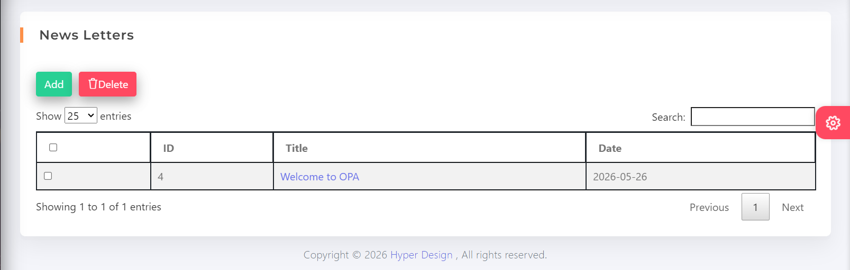
Newsletter not sending

Slide 40
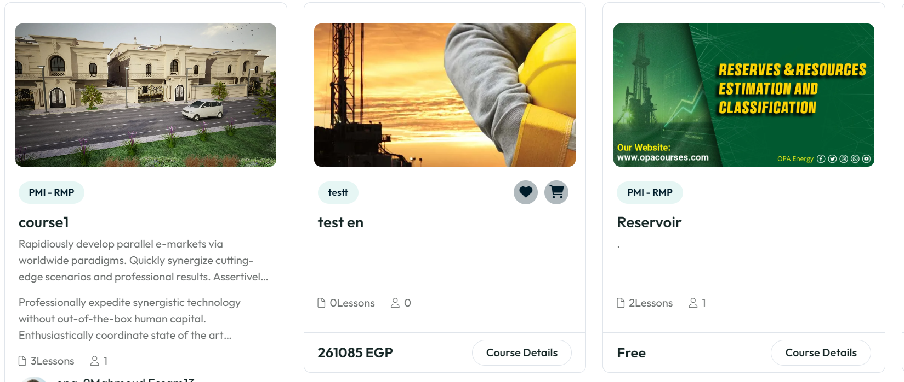
Make the course cards smaller to fit all the text- price-description.

Slide 41
Make Uppercase / Lowercase Letters in tabs menu

Slide 42
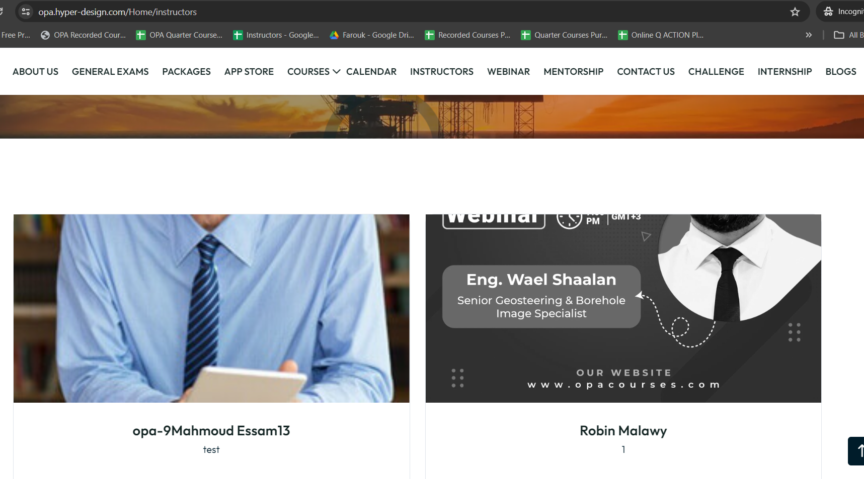
Instructors Image Fit

Slide 43
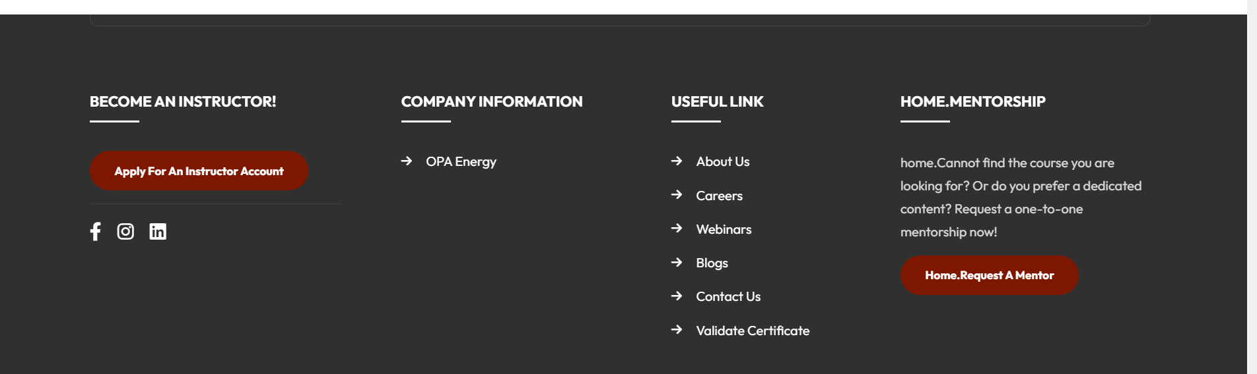
Where’s Frequently Asked Questions?
Appear here

Slide 44
Add Categories in Menus

Slide 45
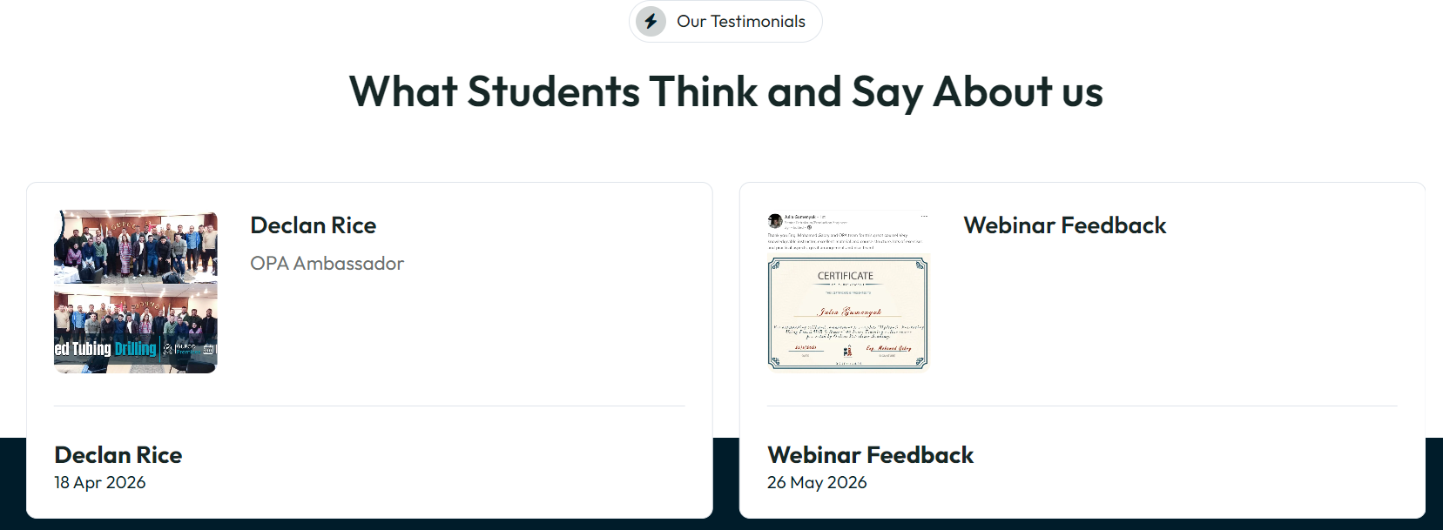
Testimonials
- We need to increase the Picture Size to be seen
- Change Students with Participants.

Slide 46
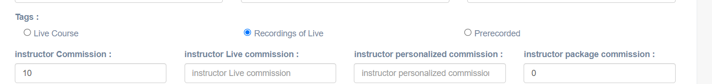
Add On Ground Courses Tab
Add Tag
Just same as courses but with no prices nobody can buy it.
Can Be assigned to users

Slide 47
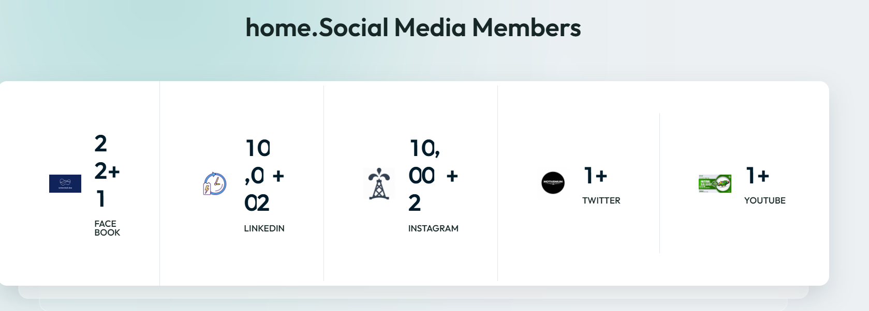
- Social media Members switch it to OPA in Numbers
- check what happens after adding 5 social media.

Slide 48

Slider content, make it editable

Slide 49
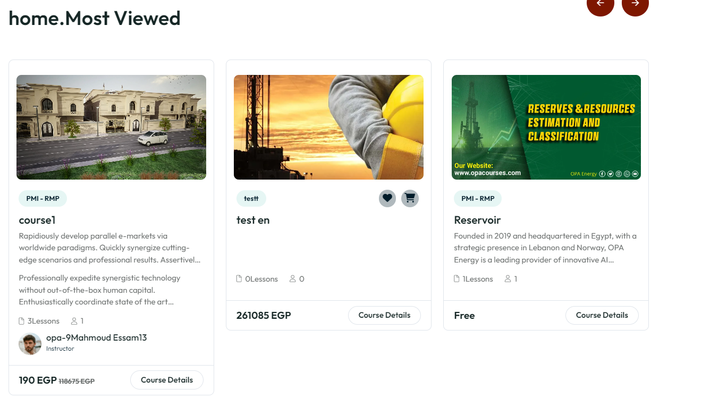
Course Cards
Limit Description with 5 lines

Slide 50
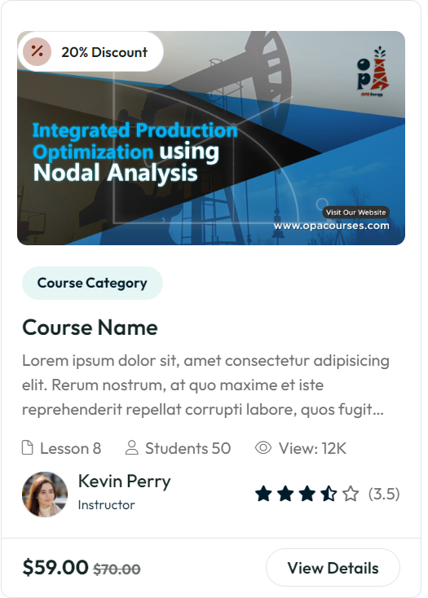
Add another tag for Live Courses next to Course Category tag
Change Students with Participants
Switch the number with lessons.
8 Lessons

Slide 51
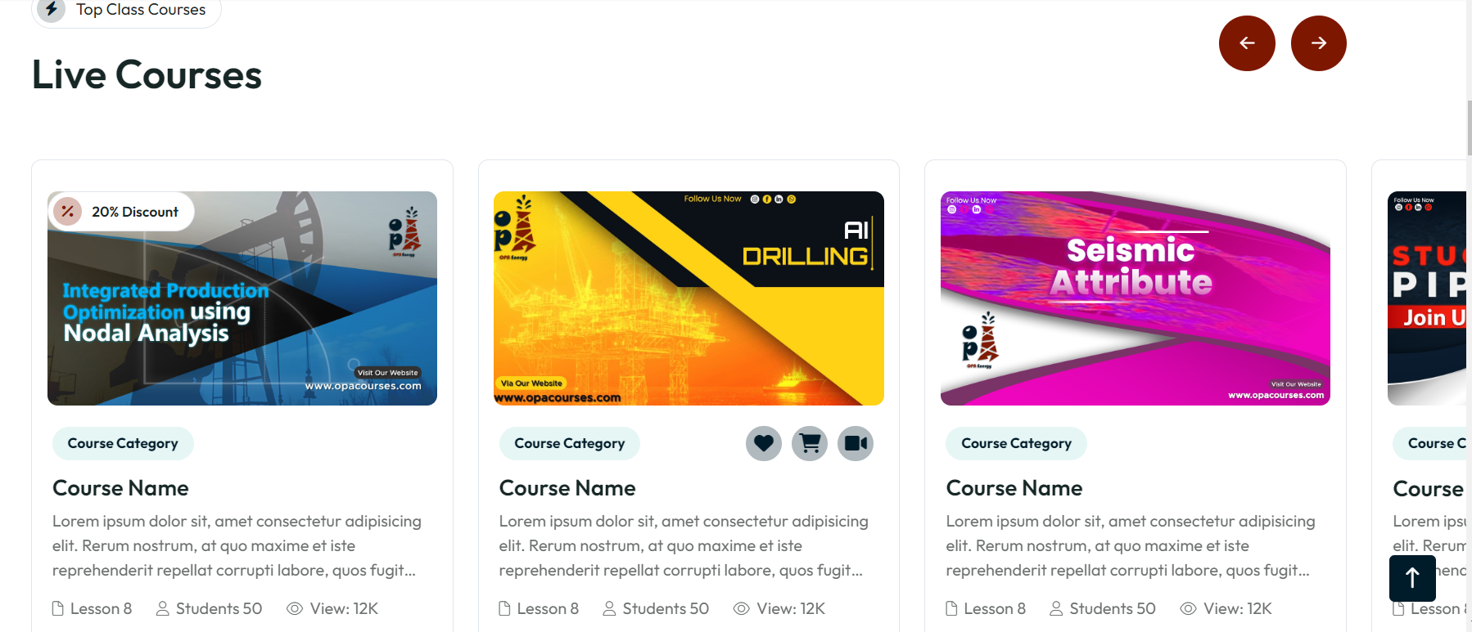
Make the slider movable with the touchpad swipe

Slide 52
Add slider for Recently Added Courses.
Limit: 3 Months (Created At)

Slide 53
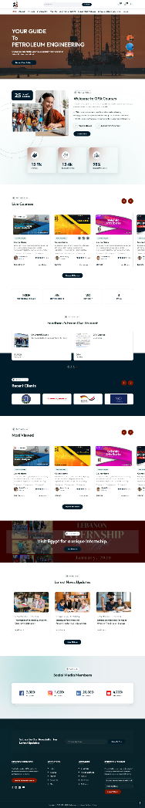
Sequence of Homepage
1
4
2
5
Replace it with best seller
3
6
7

Slide 54


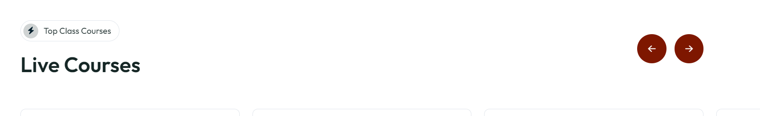
Replace with this icon

Slide 55
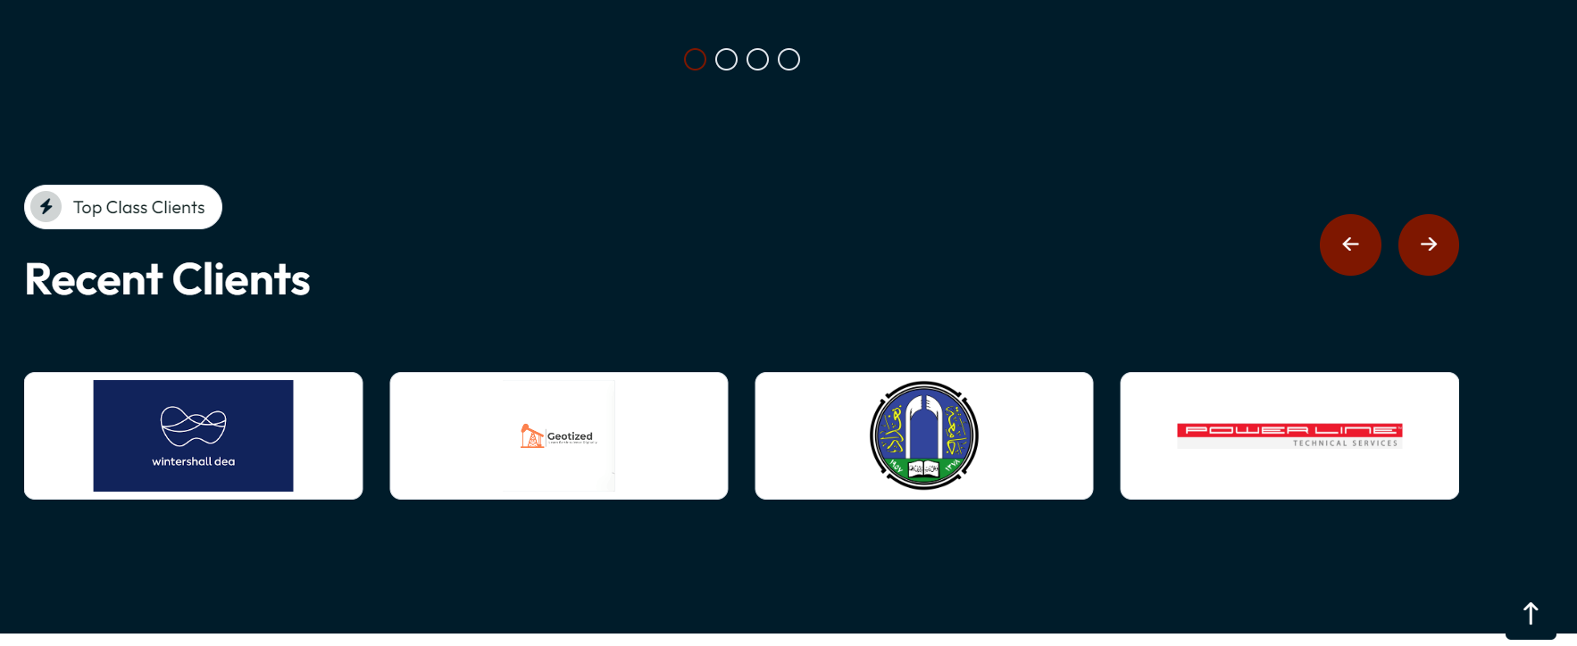
- Remove the logos borders
- Change Recent Clients to Success Partners.

Slide 56
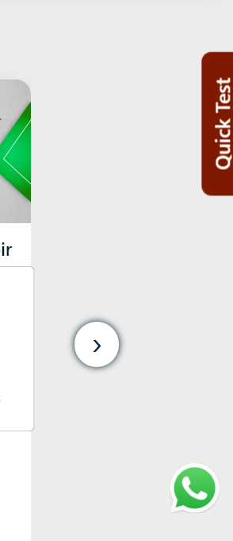
Add Quick Test and the WhatsApp Bot

Slide 57

About Us video preview not loading
Add Thumbnail (Image) in control panel to be shown

Slide 58
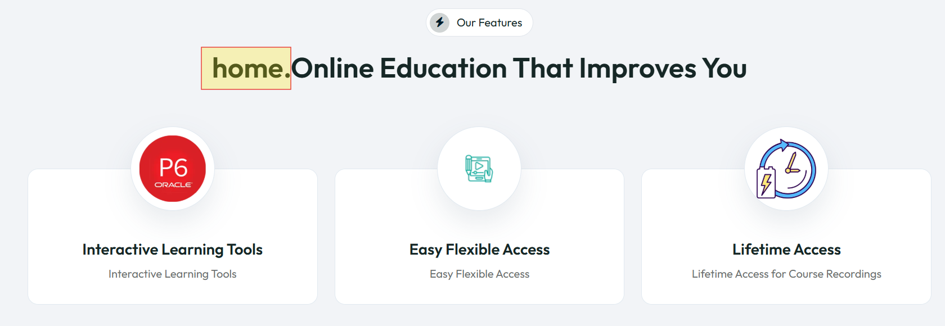
About Us

Slide 59

- We want everything to be editable from the control panel, even the icons of the registration number. (Convert Icons to Photos)
- Duplicate this Section in about us, Photos on the right.

Slide 60
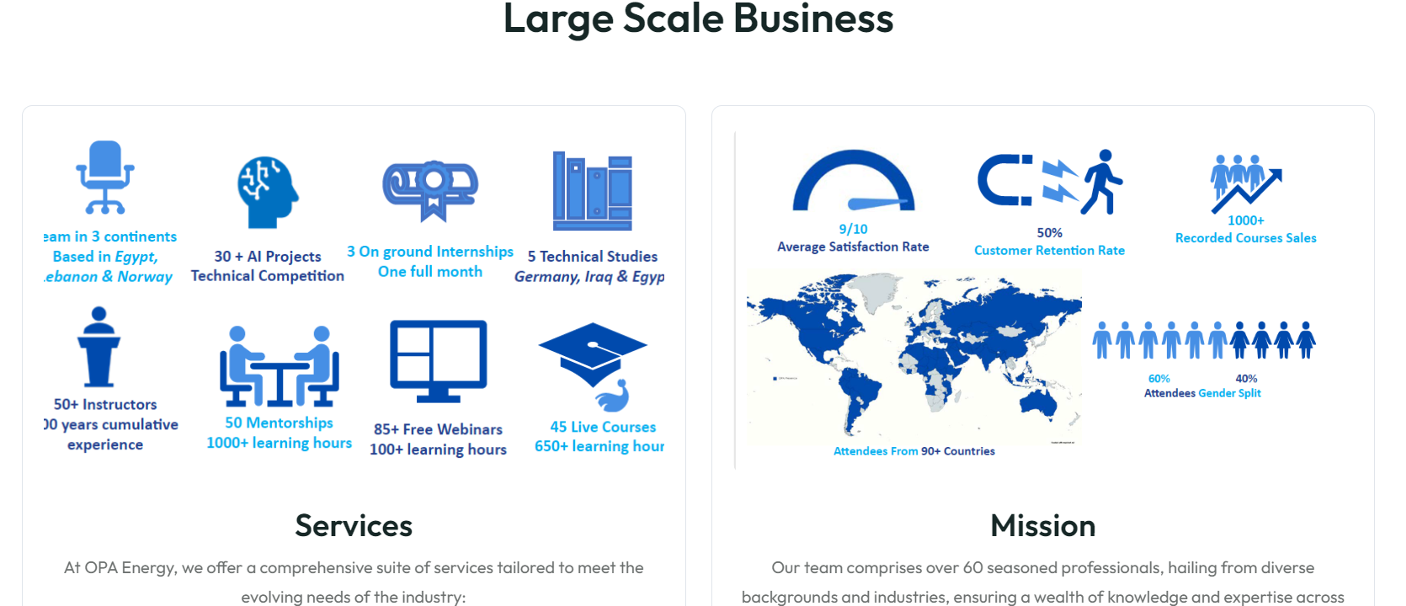
Dynamic numbers and icons and text to be editable form control panel.

Slide 61

Add WhatsApp in contact us
Show only the available Contact.

Slide 62
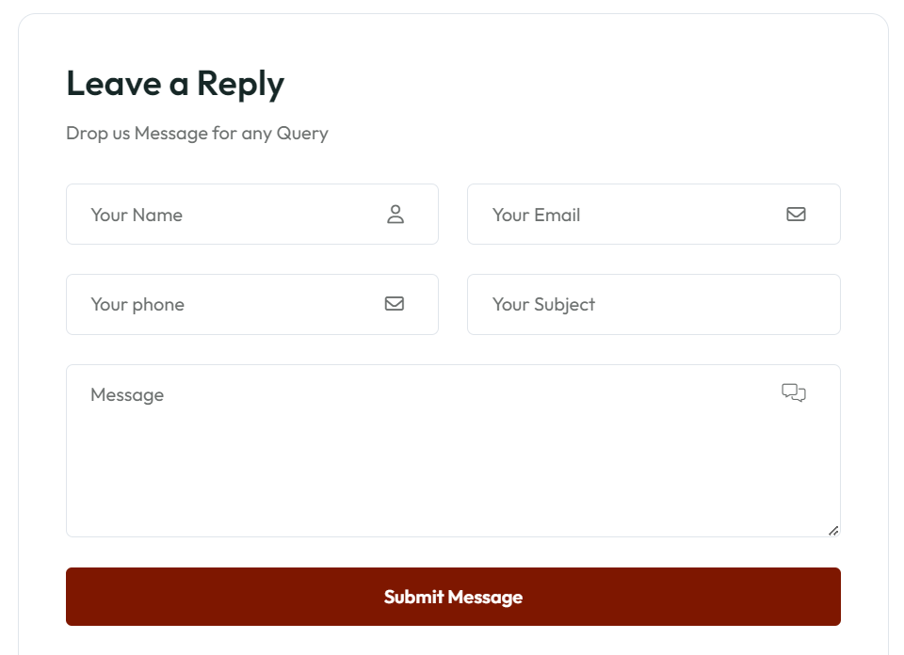
Change the Title (Leave a Reply) to
Contact Our Team

Slide 63
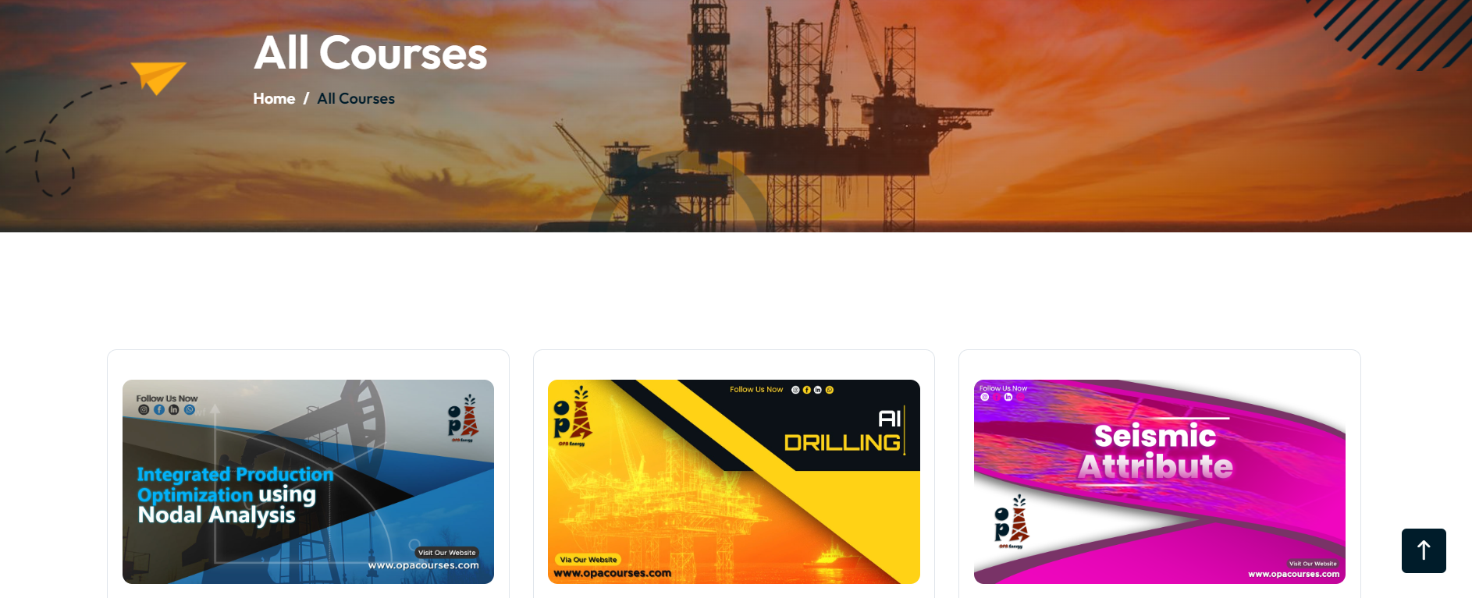
Add Filter for courses.
- Delivery Method (Live Course / Pre-recorded/ Recordings of Live Course)
- by Instructor Name
- Category ( Reservoir – Production – Rig & Rigless – etc..)
- Price
- Recently Added time frame
(3 months)

Slide 64
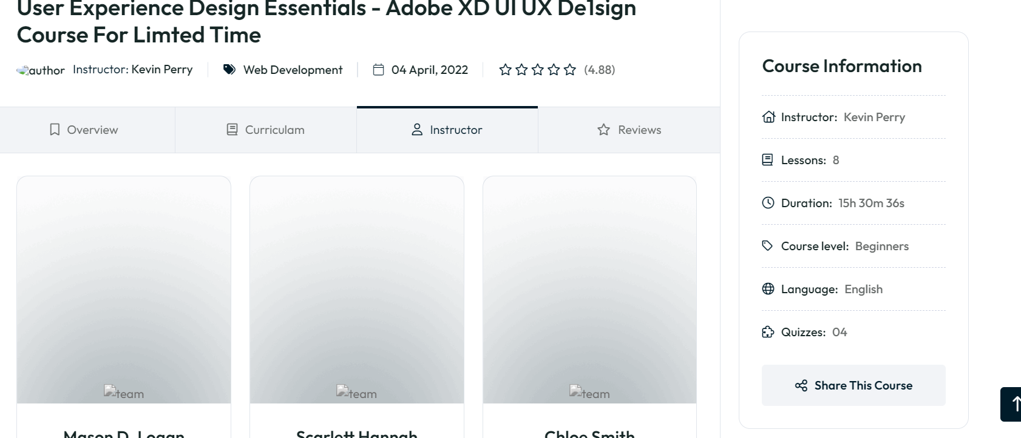
Add Instructor Bio and remove social media icons.
Change this
icon
Assignments
Add Projects (Number)
Show only if available

Slide 65
Zoom Link in Courses not appearing

Slide 66
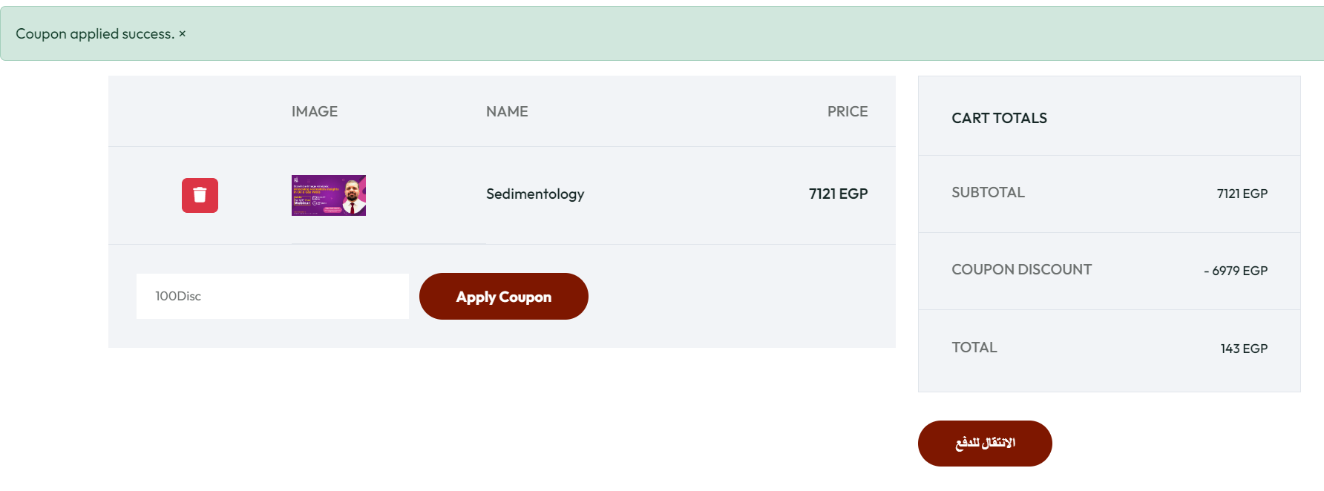
100% Discount Coupon doesn’t give 100% discount.

Slide 67
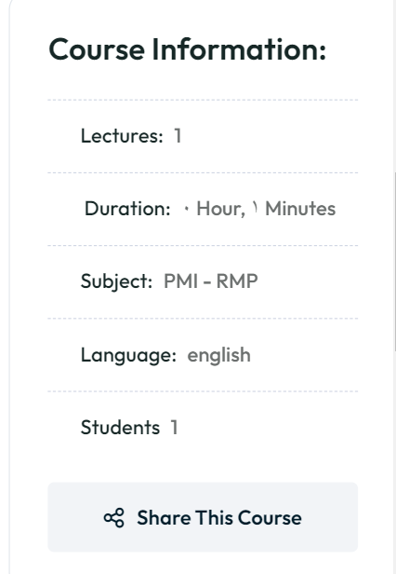
Arabic Numbers in course description and Alignment isn’t the same

Slide 68
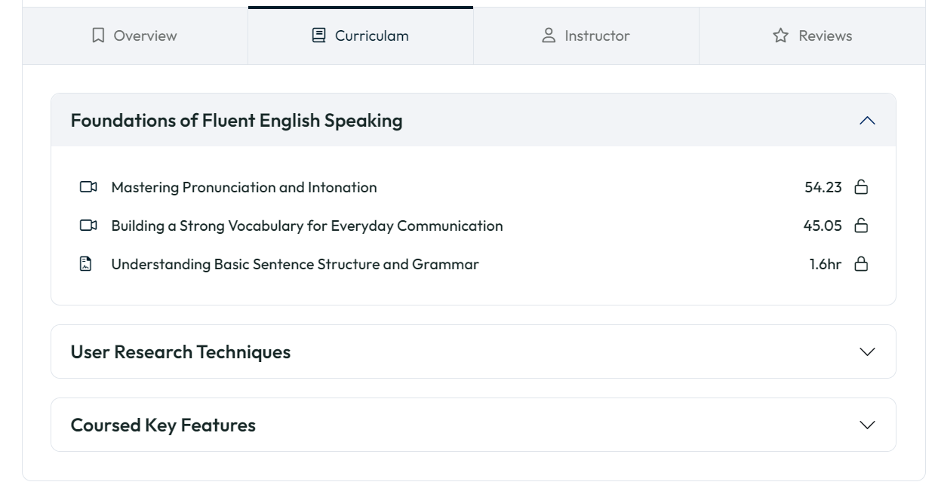
Curriculum*

Slide 69
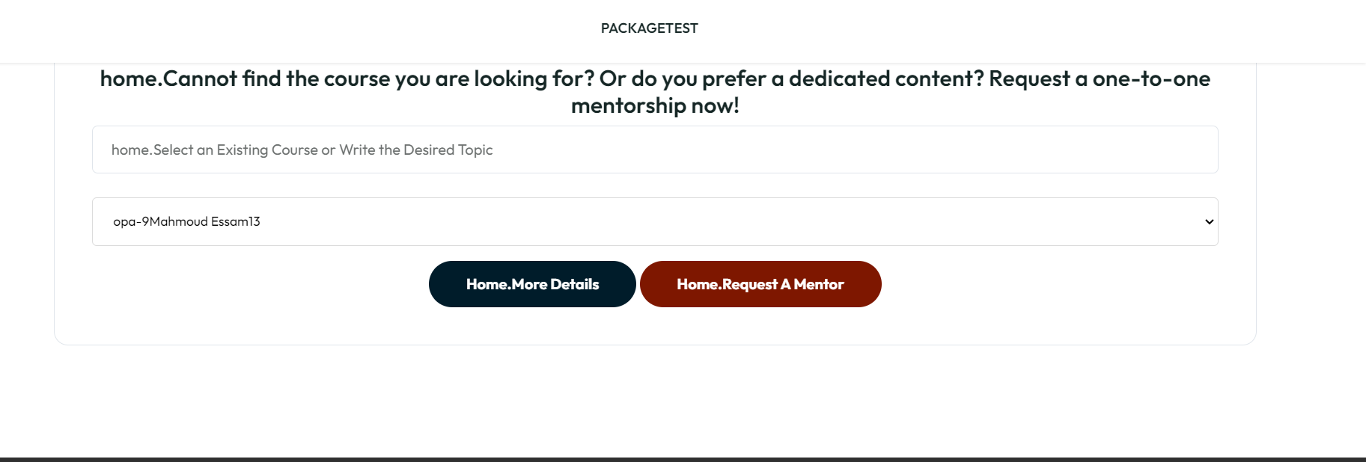
Mentorship Page same as on ground courses tab (TAG)
Add Mentorship Cards like courses (Title – Country- Company- Image)
Make the form as a mini box.

Slide 70
Webinar Page same as old web
Youtube Embedded Video and organize the buttons and the paragraph blocks.

Slide 71

Webinar Youtube Isn’t working

Slide 72

Webinar Certificate Generation not workin

Slide 73

Add Filter for the webinar based on Category (Also add a category option to the control panel)
- Add Search for Webinars

Slide 74

Replace the 4 blocks with the Categories.
Photo with title (Category)
Category Page when I click on it, it shows the blog items

Slide 75

In Blogs, Add Button if we want to refer to Course / App Store (input link in control panel)

Slide 76
Courses can’t be added to cart

Slide 77


Cart
- add course details
- You Might Also Like
- Mention to the Current Discount

Slide 78

Remove the “Fill-up the form to login”

Slide 79

Fixed Size for Course Cards.

Slide 80
Internship Page
Add PDF to the PAGE below the slider
Add in Settings (Add Internship File)

Slide 81

Make the internship images as slider

Slide 82

Add PDF Column
Make Categories next to each other (Tabs)

Slide 83

Minimize the calendar a bit,
Put the Search Bar above it. https://opa.hyper-design.com/Home/calendar

Slide 84

Website Link Preview
https://opa.hyper-design.com/

Slide 85

Course Link Preview

Slide 86

Webinar Link Preview

Slide 87
Blogs Link Preview
same

Slide 88
Show Image in all link previews.

